Slide 1
A Jump Start to OpenCL
Another Language to Program Parallel Computing Devices
March 15, 2009
CIS 565/665 – GPU Computing and Architecture

Slide 2
Sources
OpenCL Tutorial - Introduction to OpenCL
OpenCL for NVIDIA GPUs – Chris Lamb
OpenCL – Parallel Computing for Heterogeneous Devices (SIGGASIA) – Kronos Group
NVIDIA OpenCL Jump Start Guide
OpenCL – Making Use of What You’ve Got
OpenCL Basics and Advanced (PPAM 2009) – Domink Behr

Slide 3
Sources
OpenCL Tutorial - Introduction to OpenCL
OpenCL for NVIDIA GPUs – Chris Lamb
OpenCL – Parallel Computing for Heterogeneous Devices (SIGGASIA) – Kronos Group
NVIDIA OpenCL Jump Start Guide
OpenCL – Making Use of What You’ve Got
OpenCL Basics and Advanced (PPAM 2009) – Domink Behr

Slide 4
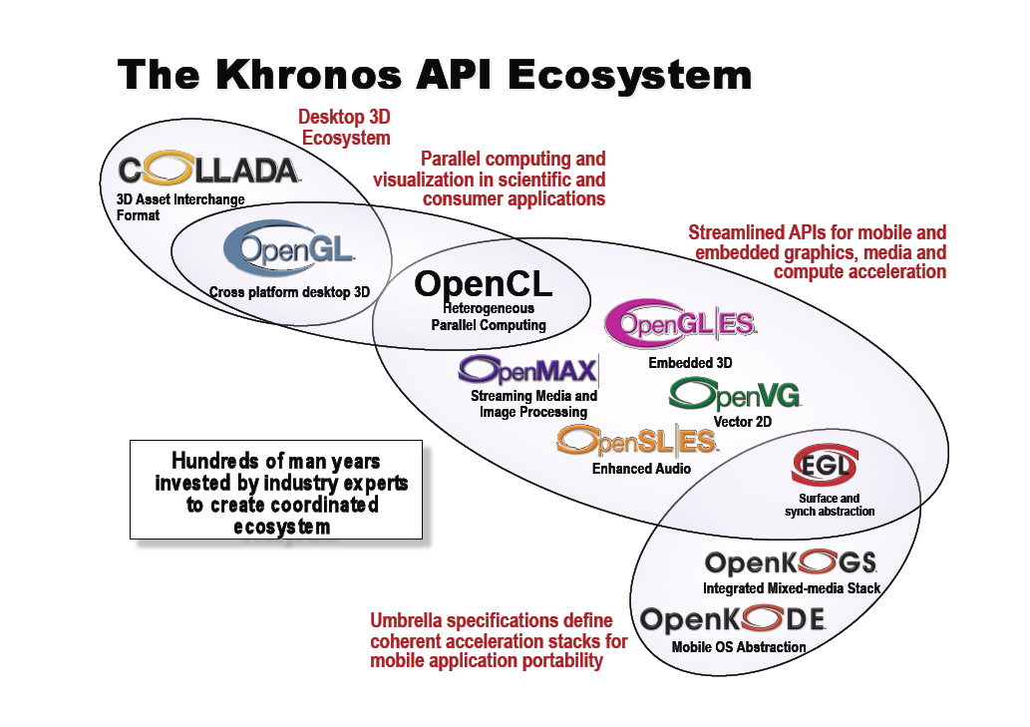

Slide 5


Slide 6
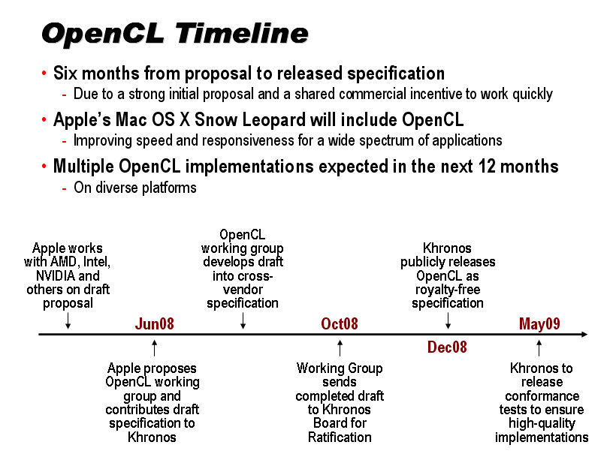

Slide 7


CUDA Working Group
Because of Nexus and Visual Studio Integration….

Slide 8
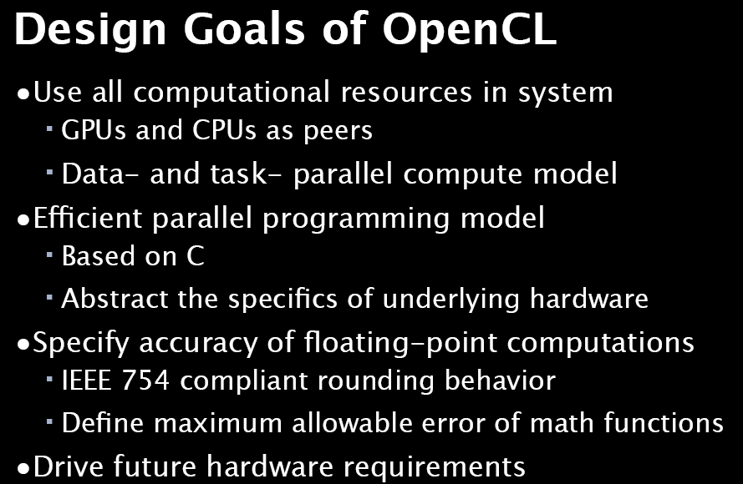

Slide 9
Anatomy of OpenCL
Language Specification
  C-based cross-platform programming interface
  Subset of ISO C99 with language extensions - familiar to developers
  Well-defined numerical accuracy (IEEE 754 rounding with specified max error)
  Online or offline compilation and build of compute kernel executables
  Includes a rich set of built-in functions
Platform Layer API
  A hardware abstraction layer over diverse computational resources
  Query, select and initialize compute devices
  Create compute contexts and work-queues
Runtime API
  Execute compute kernels
  Manage scheduling, compute, and memory resources
Notes:
WMP Overview
Copyright 2005, All rights reserved

Slide 10
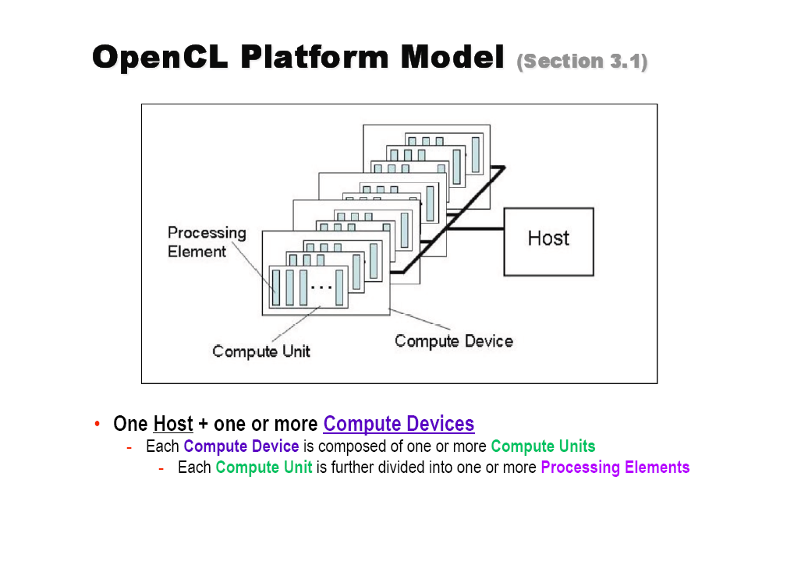

Slide 11
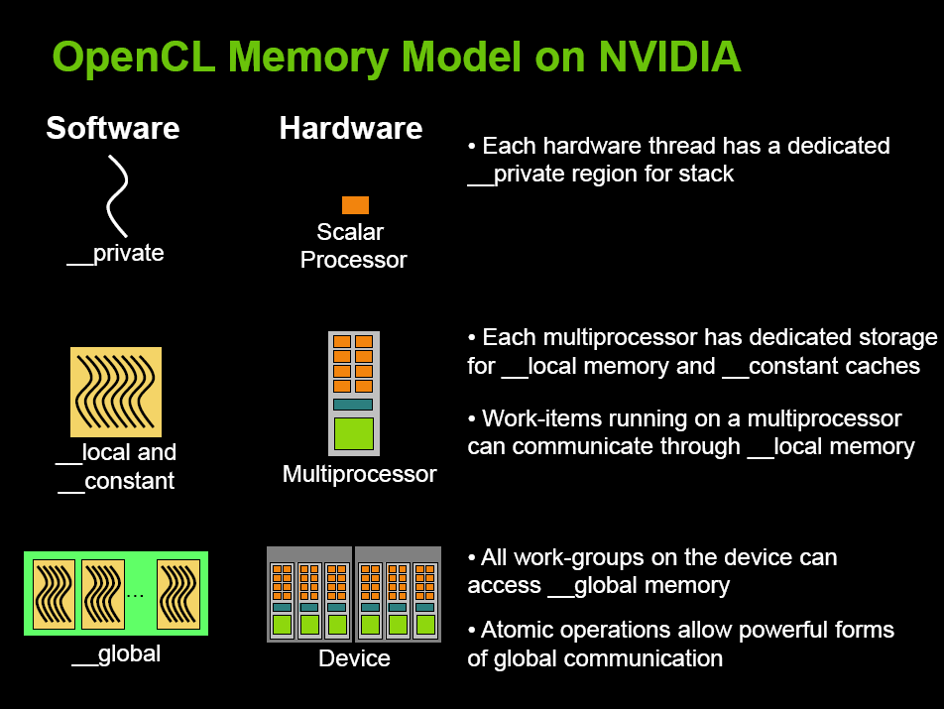

Slide 12
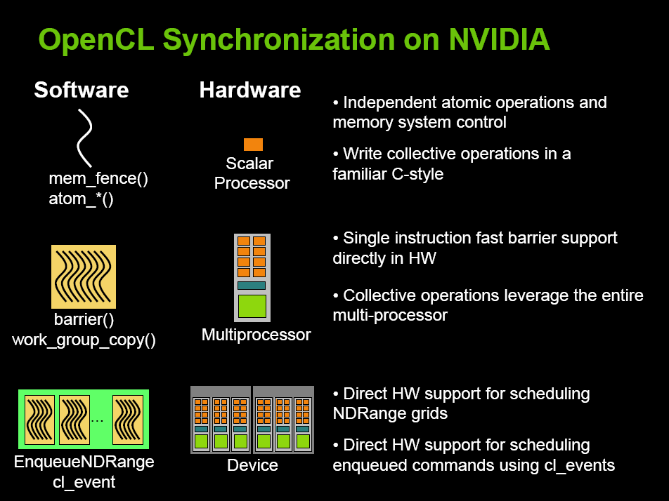

Slide 13
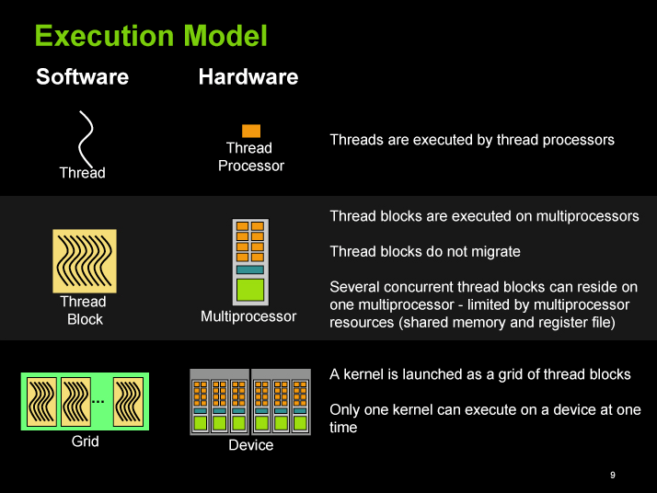
CUDA

Slide 15
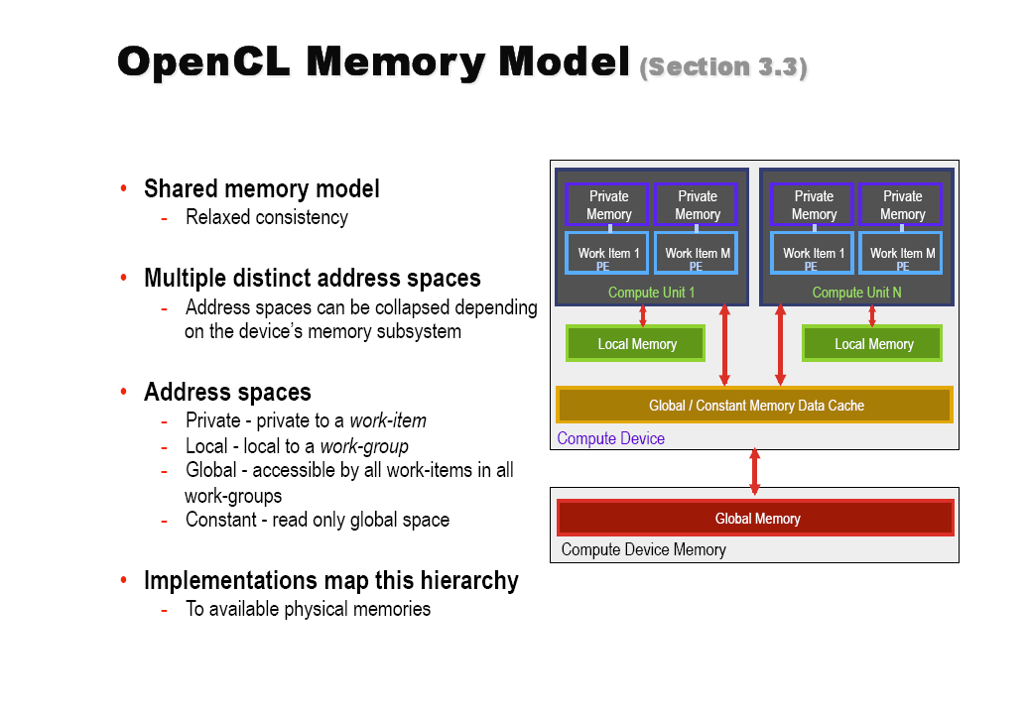

Slide 16
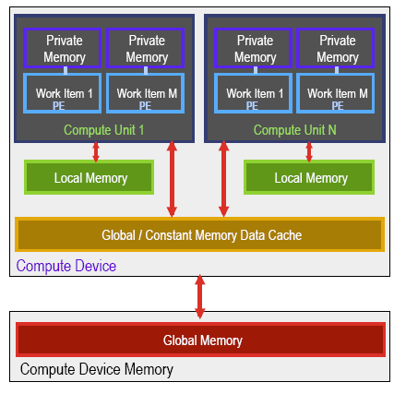
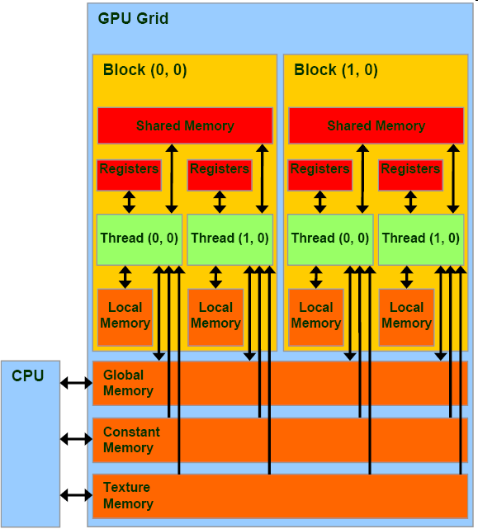
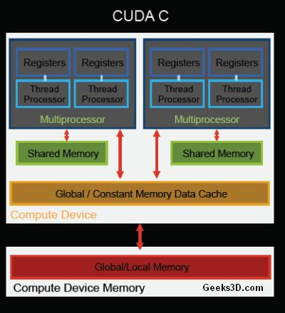
Memory Model Comparison
OpenCL CUDA

Slide 17
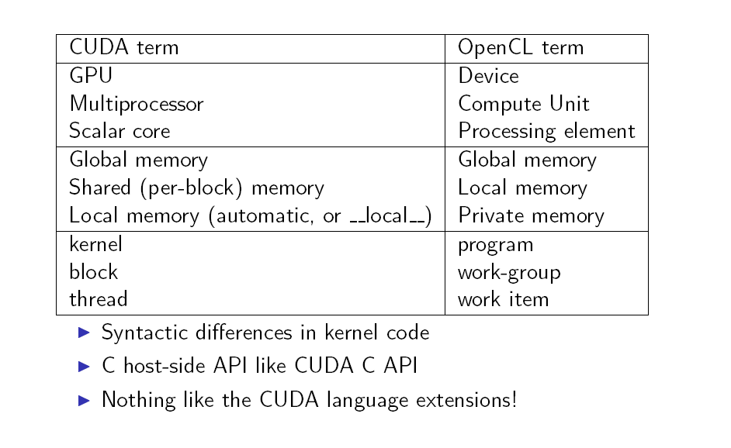
CUDA vs OpenCL

Slide 18
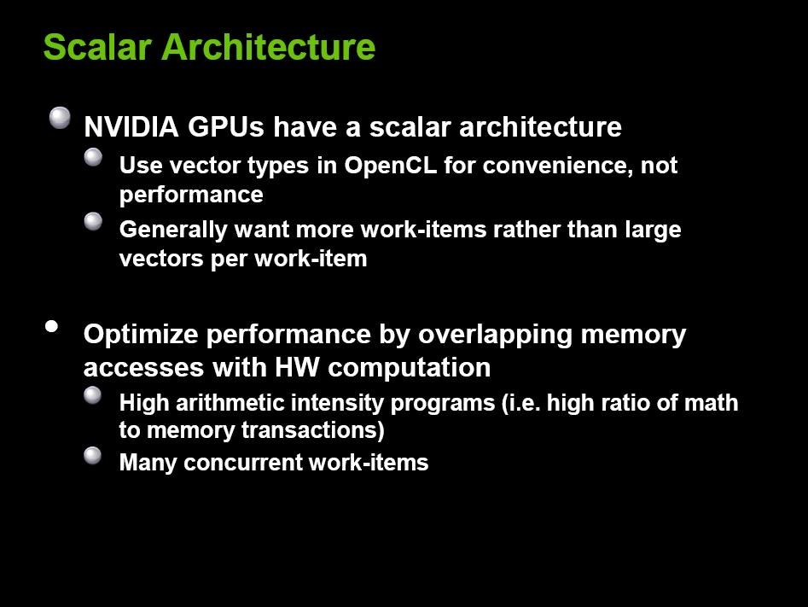

Slide 19
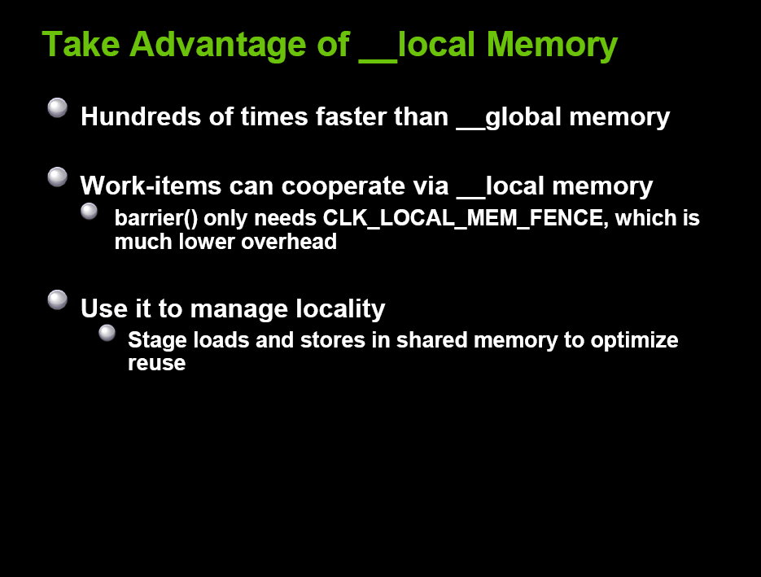

Slide 20
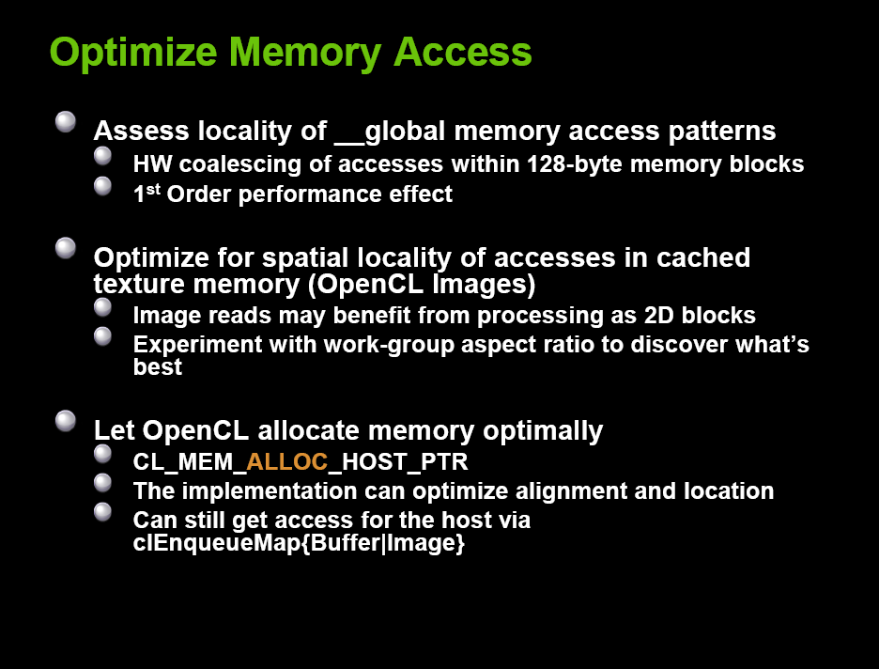

Slide 21
Architecture – Execution Model
Kernel – Smallest unit of execution, like a C function
Host program – A collection of kernels
Work item, an instance of kernel at run time
Work group, a collection of work items

Slide 22
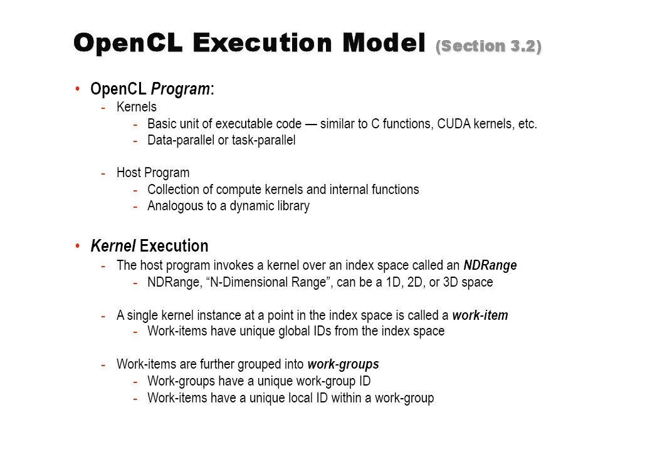

Slide 23


Slide 24
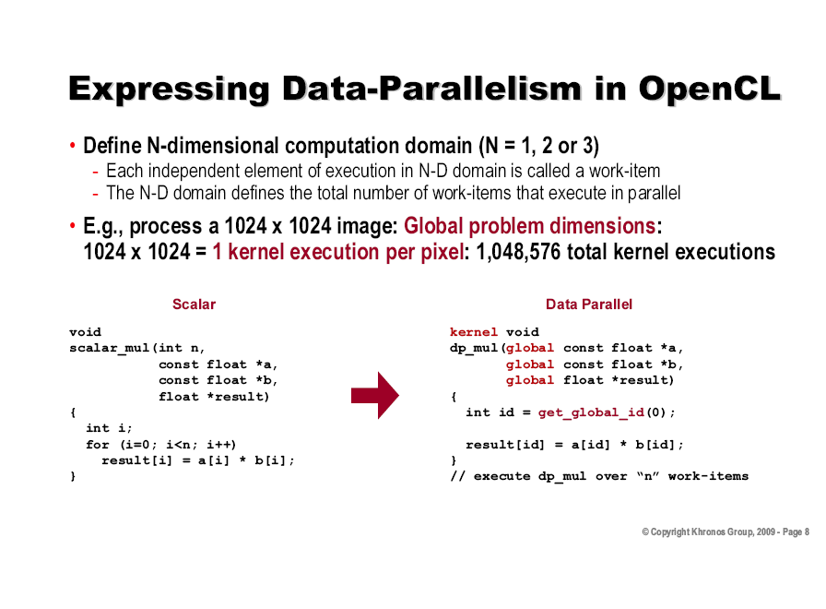

Slide 25
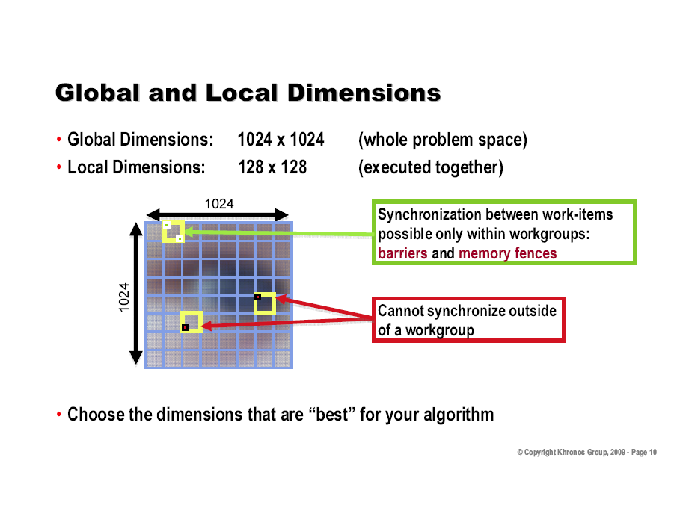

Slide 26
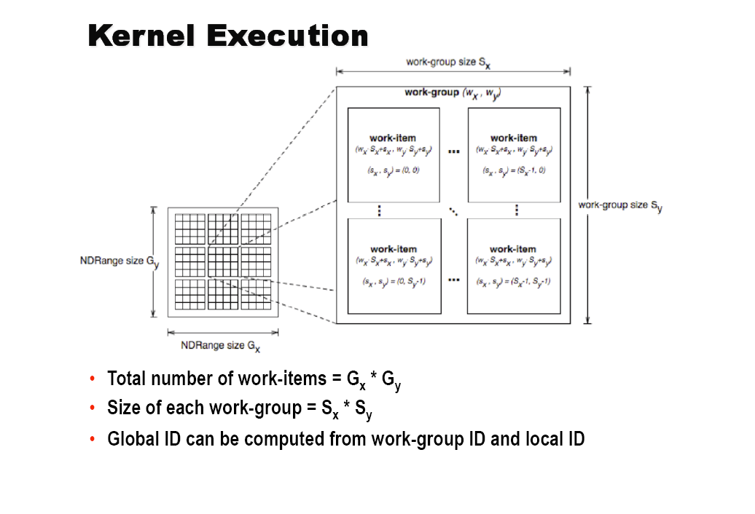

Slide 27
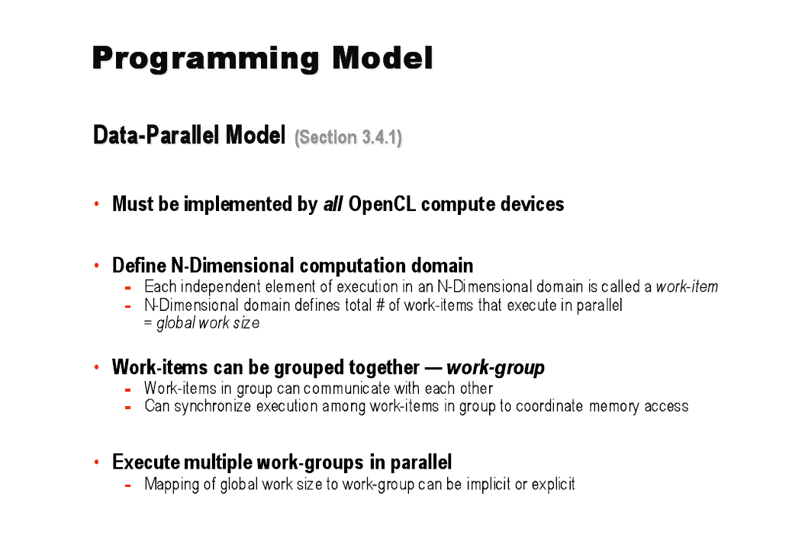

Slide 28
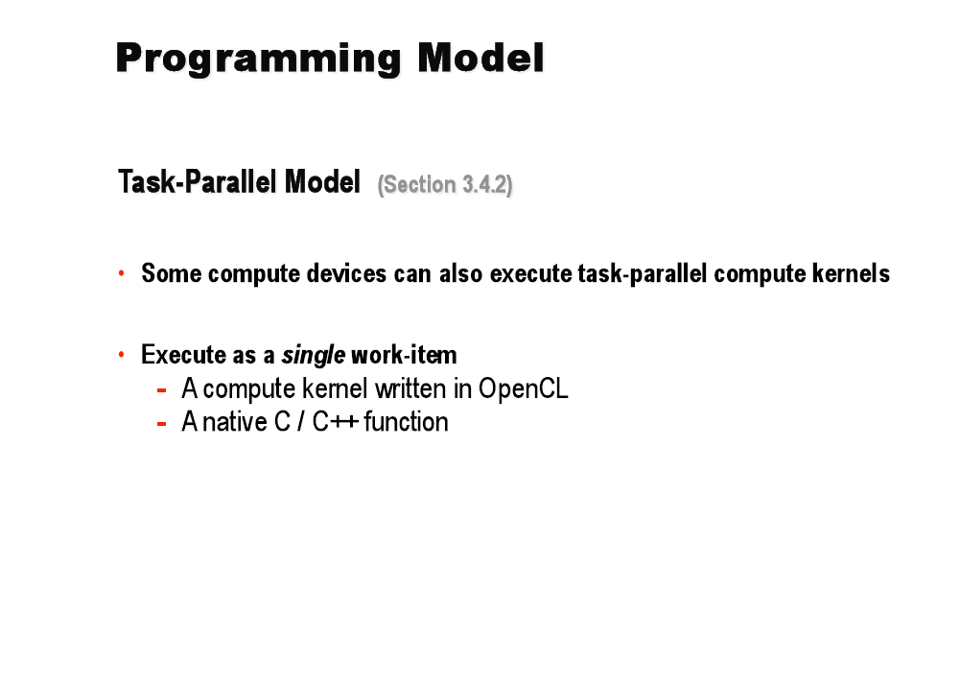

Slide 29
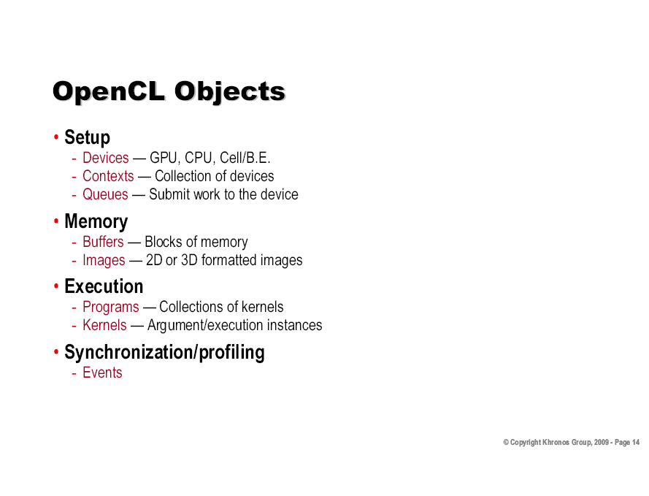

Slide 30
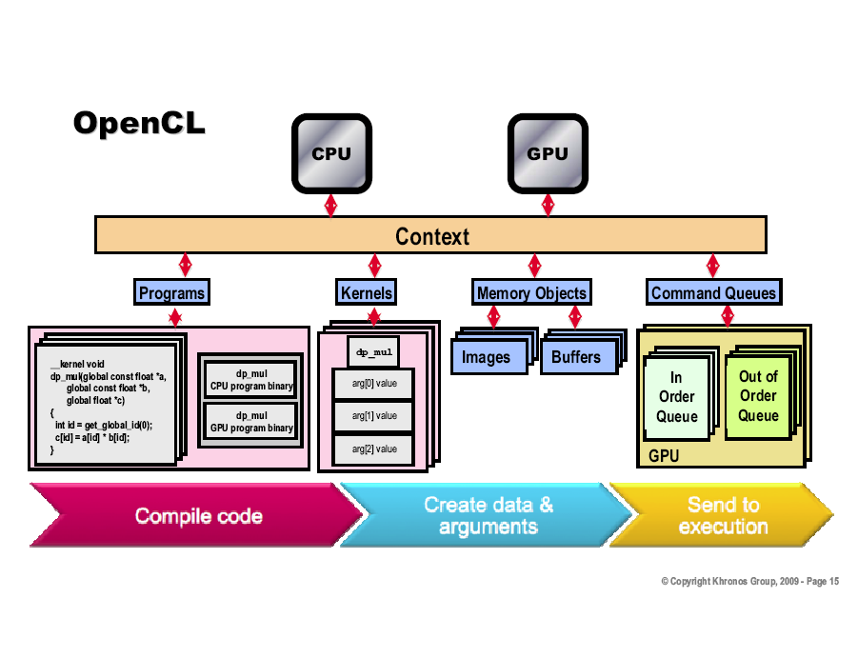

Slide 31
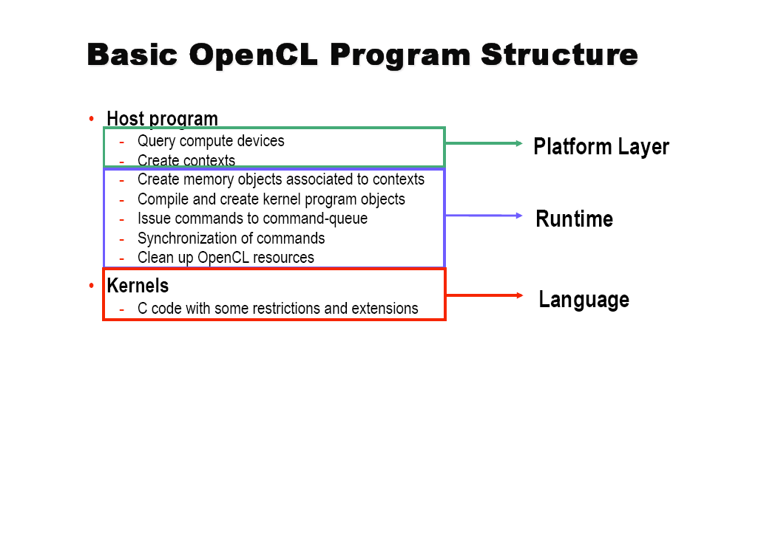

Slide 32
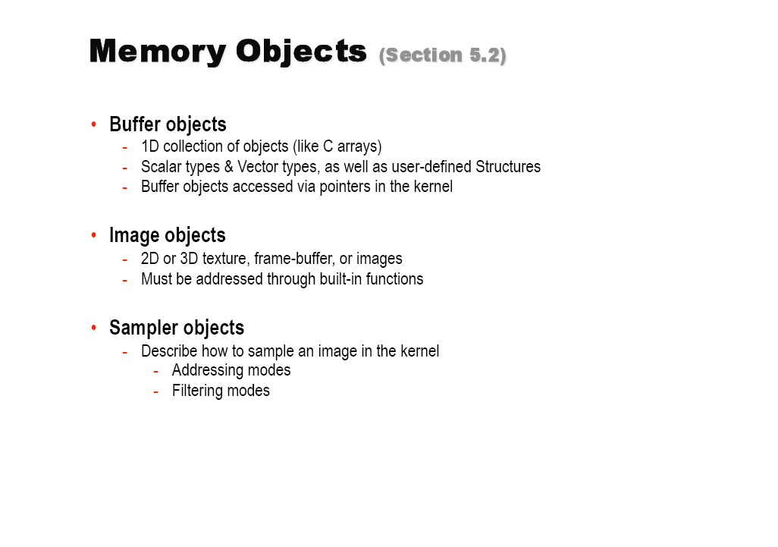

Slide 33
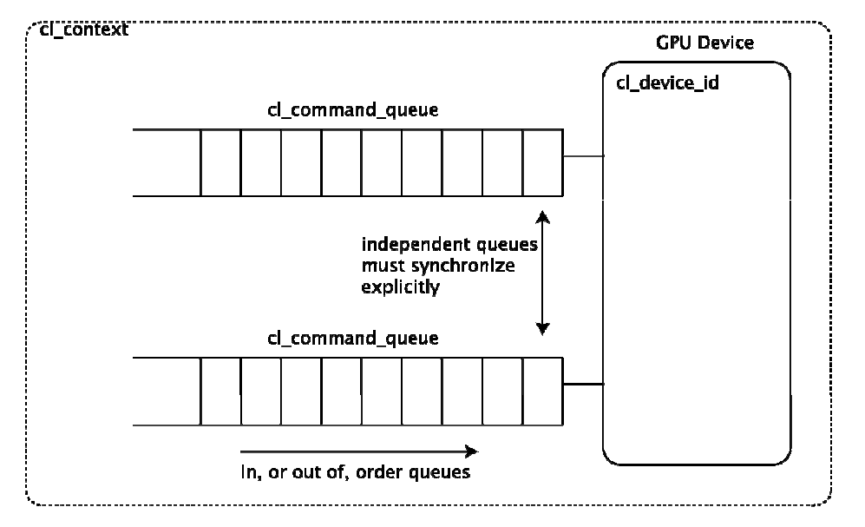
Command Queues

Slide 34
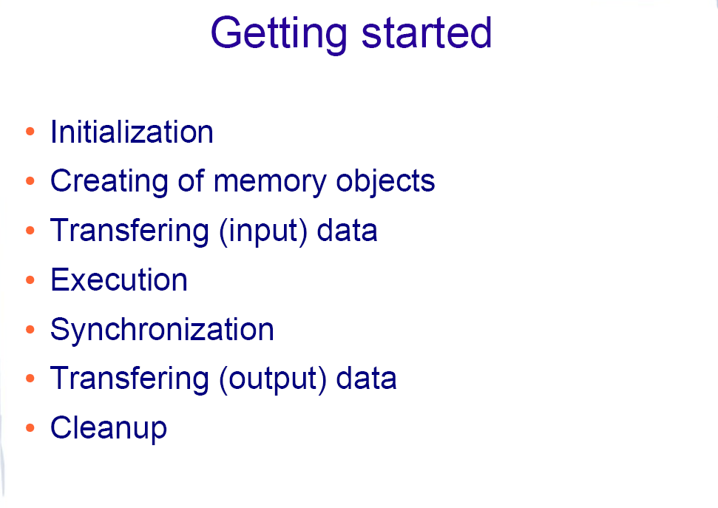

Slide 35
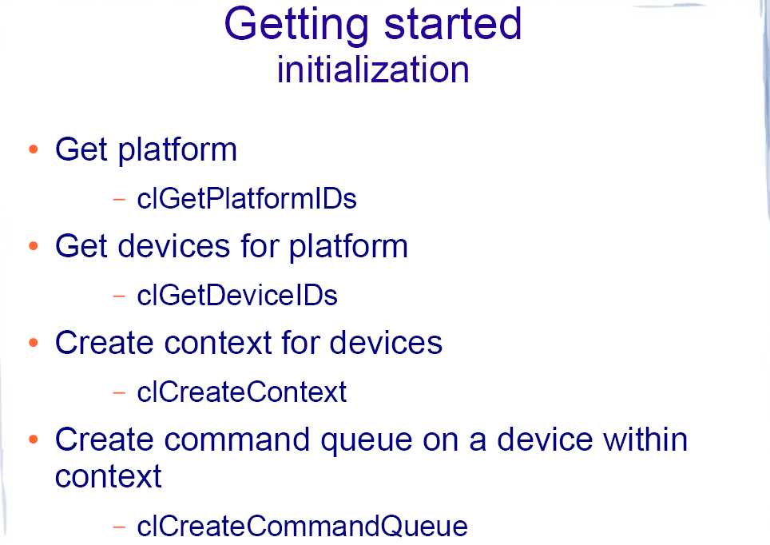

Slide 36
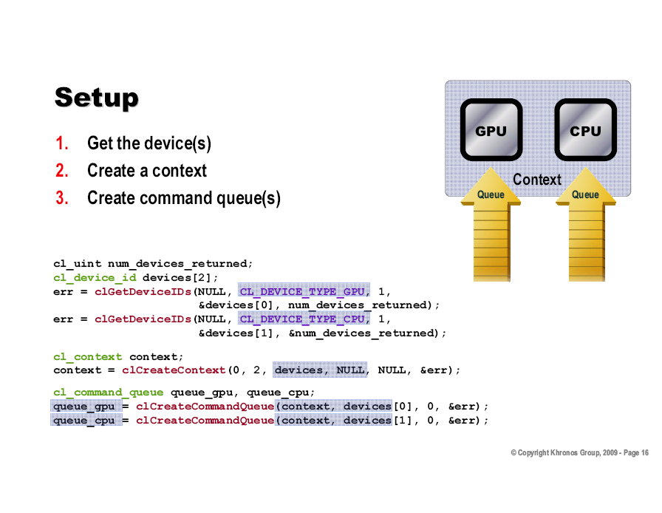

Slide 37
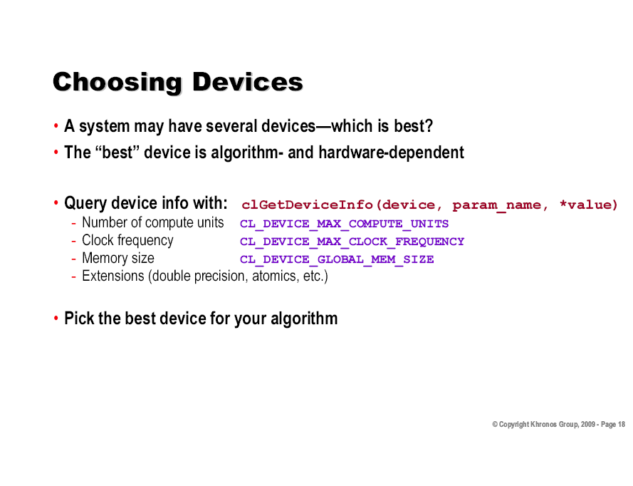

Slide 38
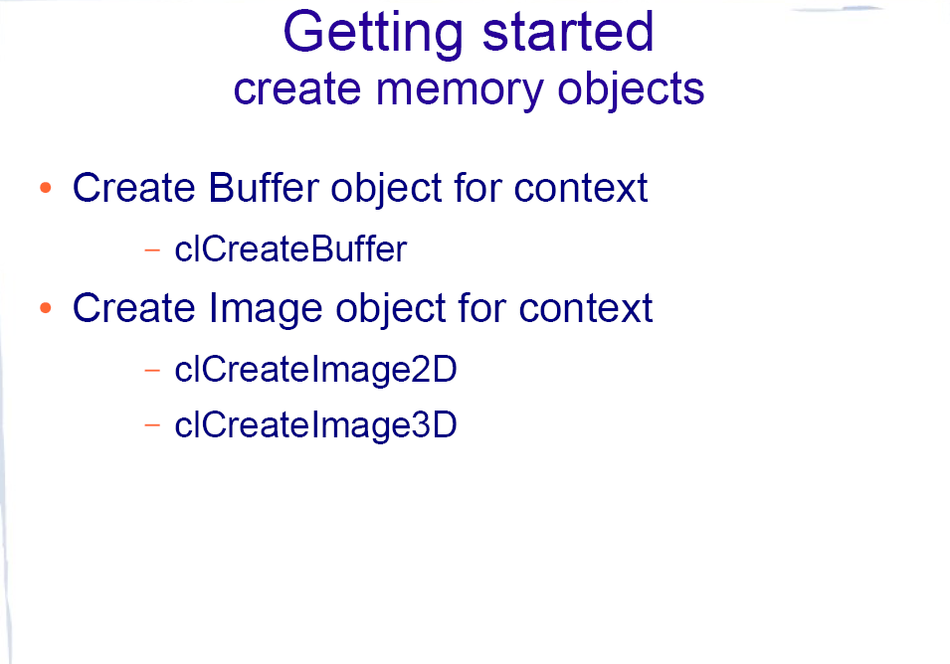

Slide 39
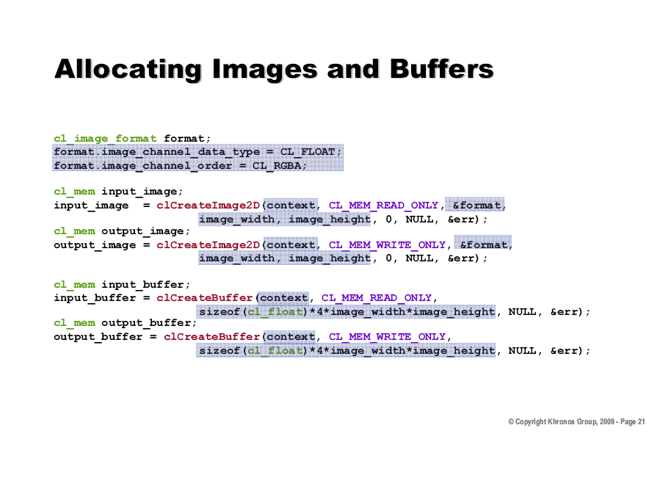

Slide 40
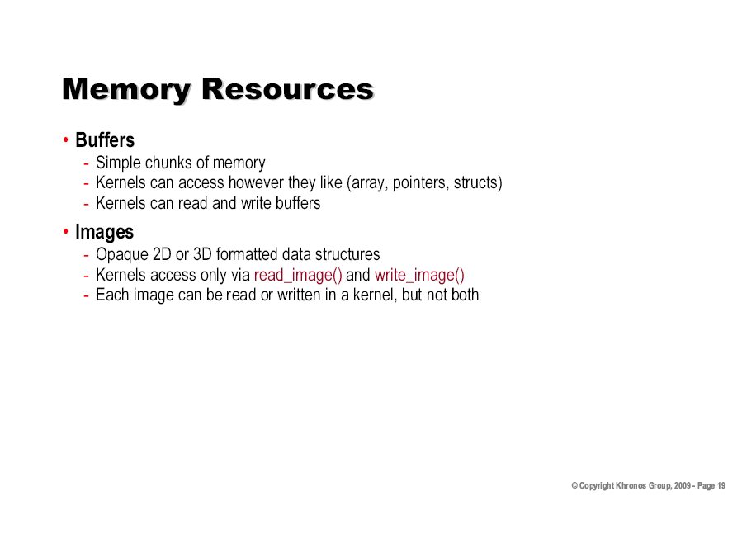

Slide 41
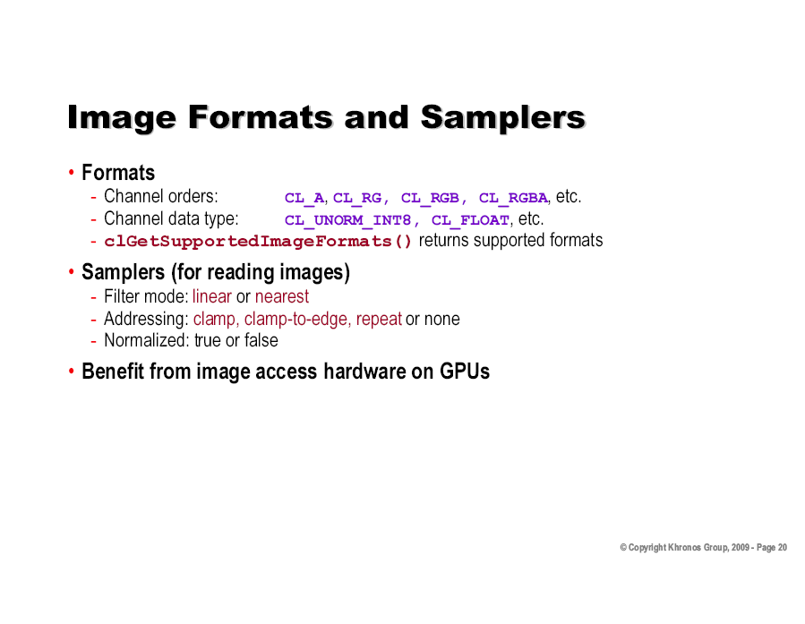

Slide 42
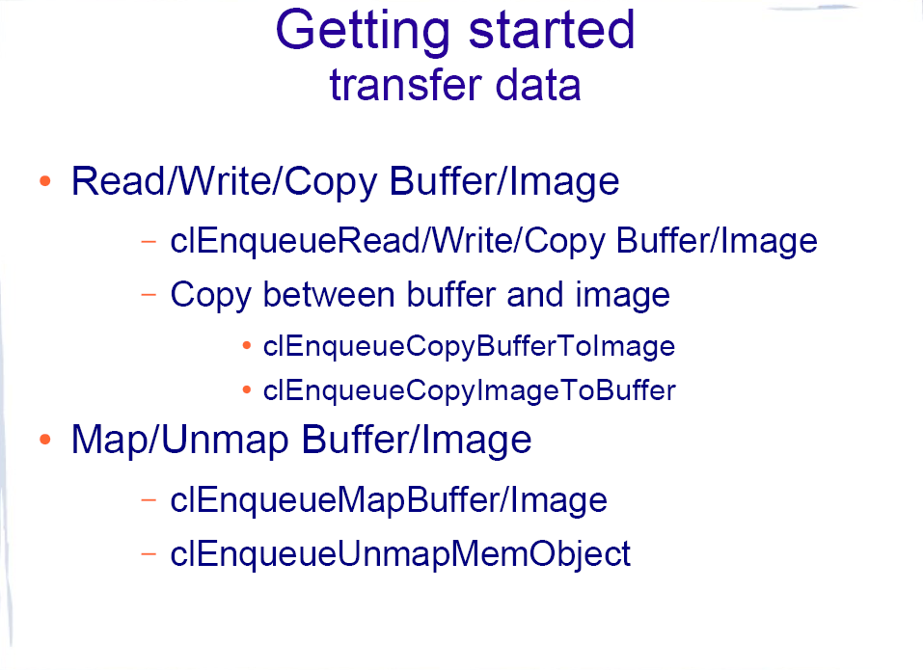

Slide 43
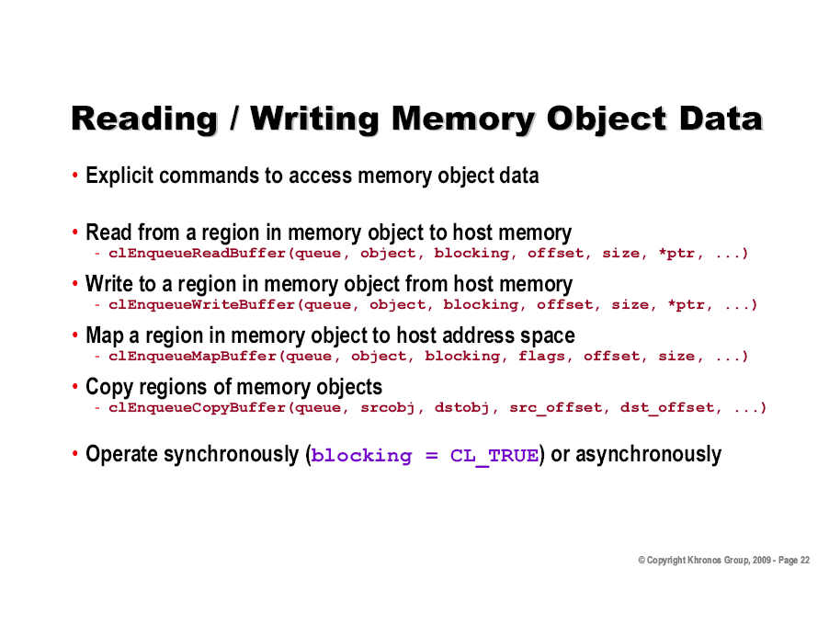

Slide 44
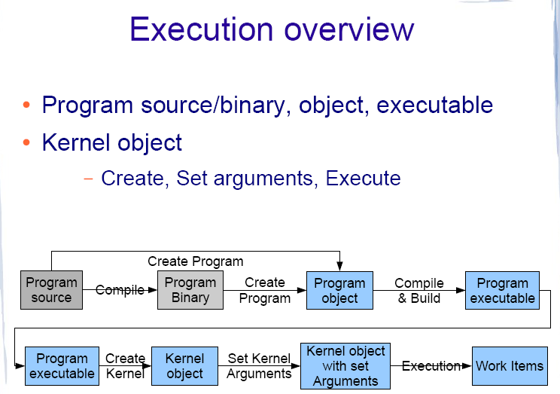

Slide 45
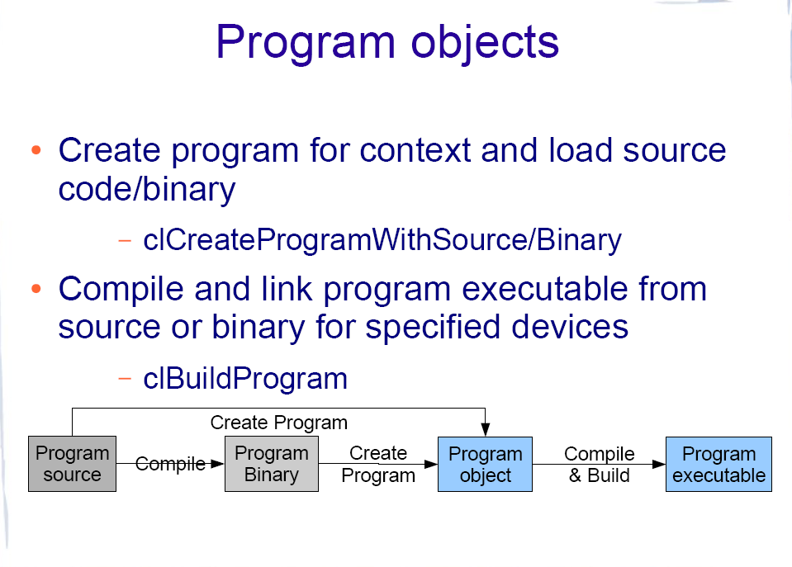

Slide 46
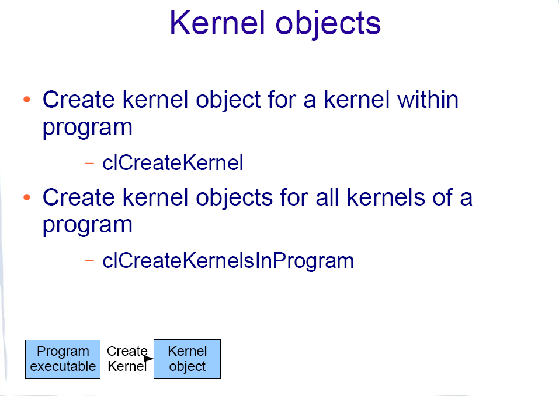

Slide 47
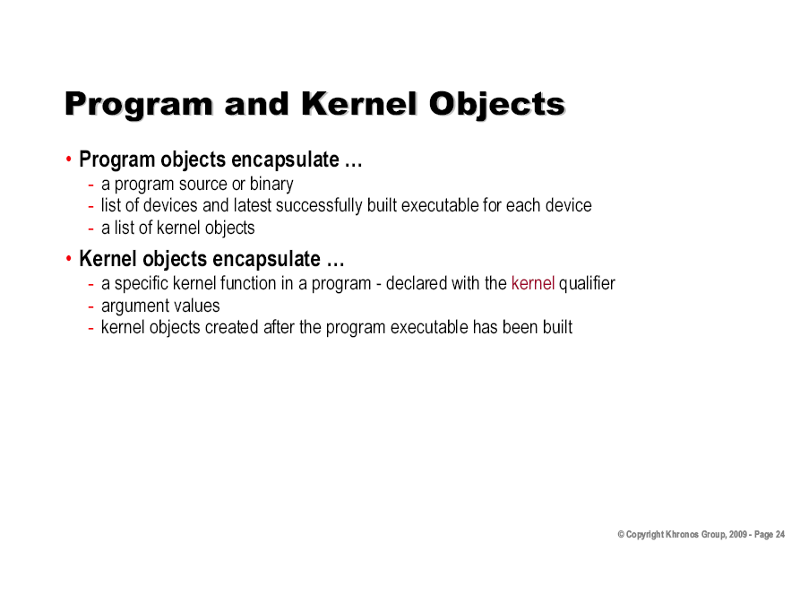

Slide 48
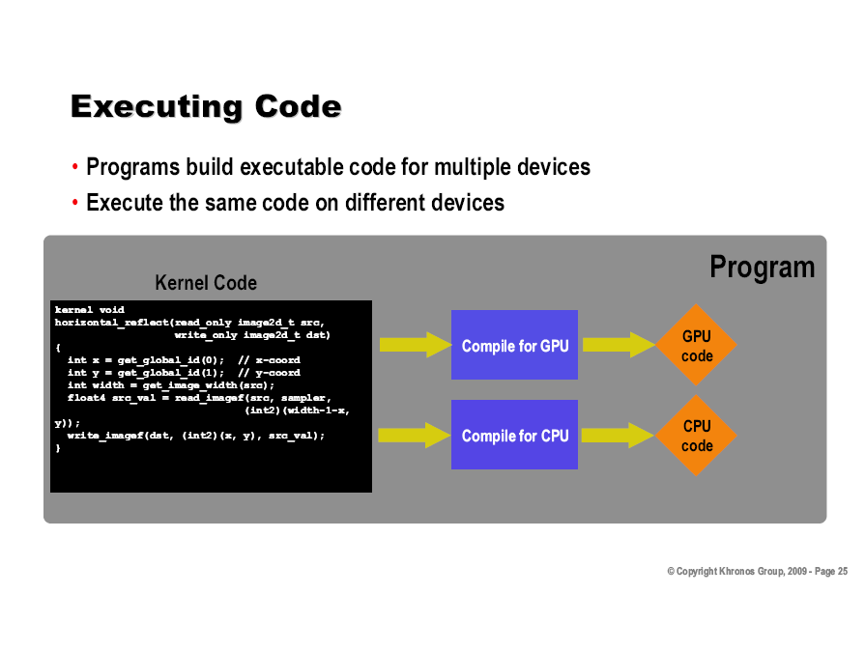

Slide 49
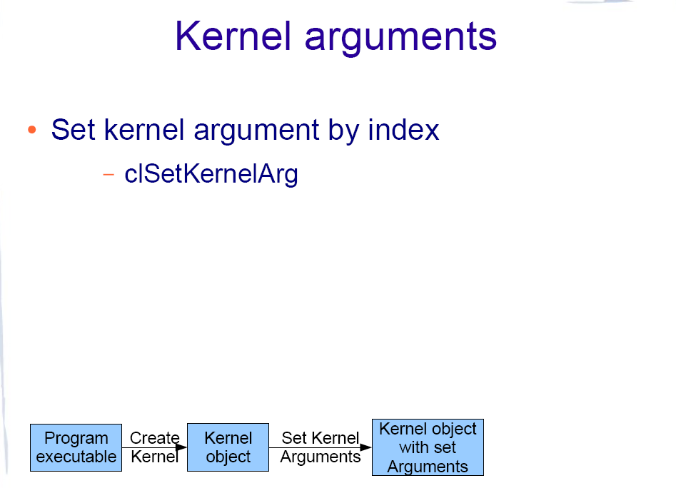

Slide 50
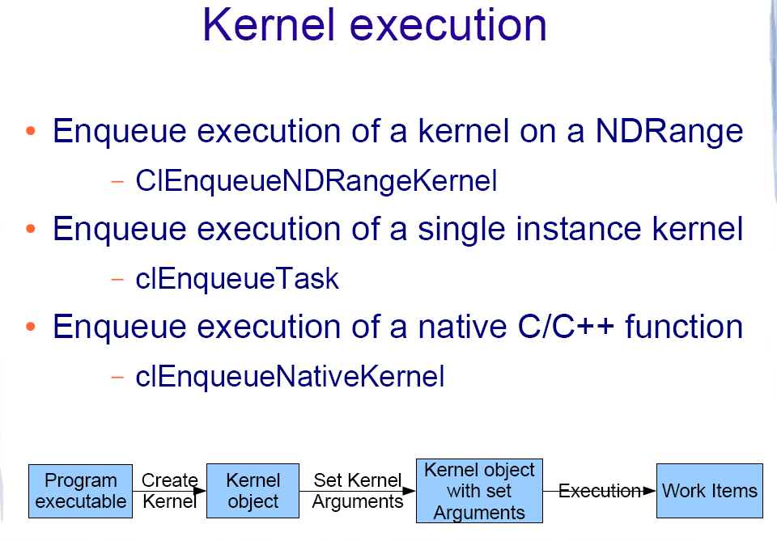

Slide 51
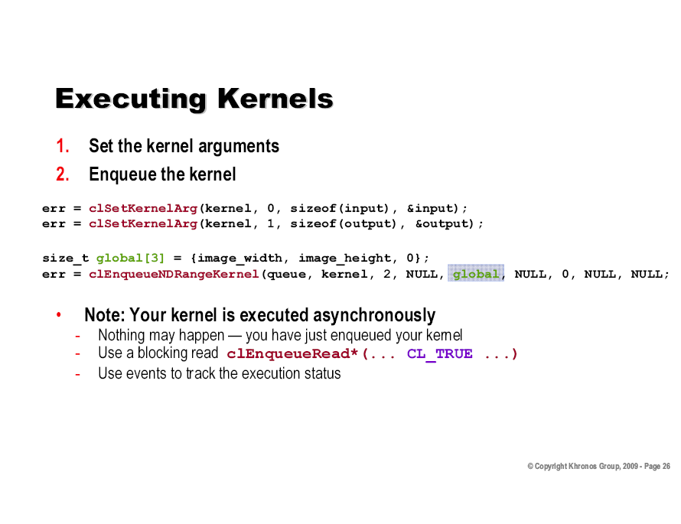

Slide 52
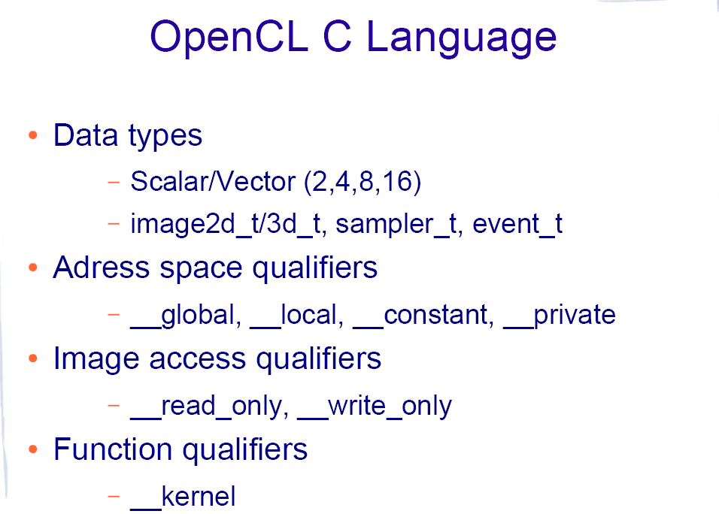

Slide 53
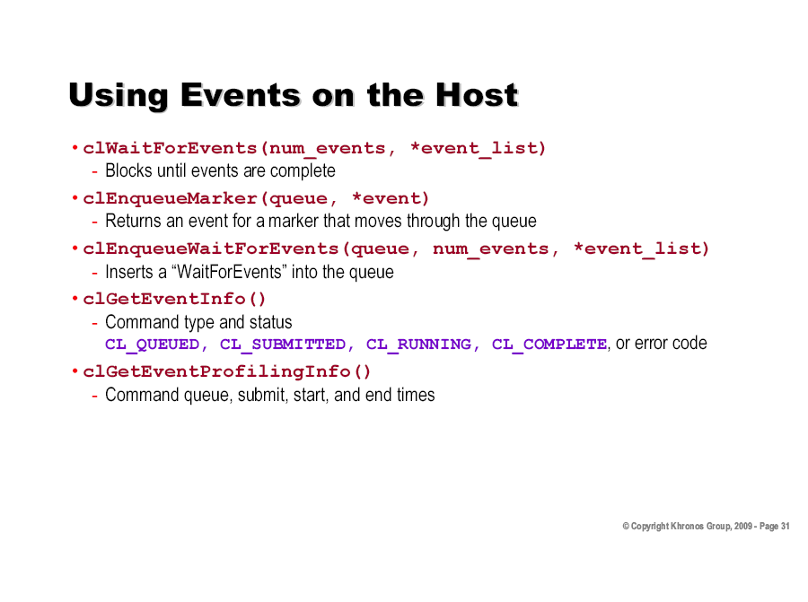

Slide 54
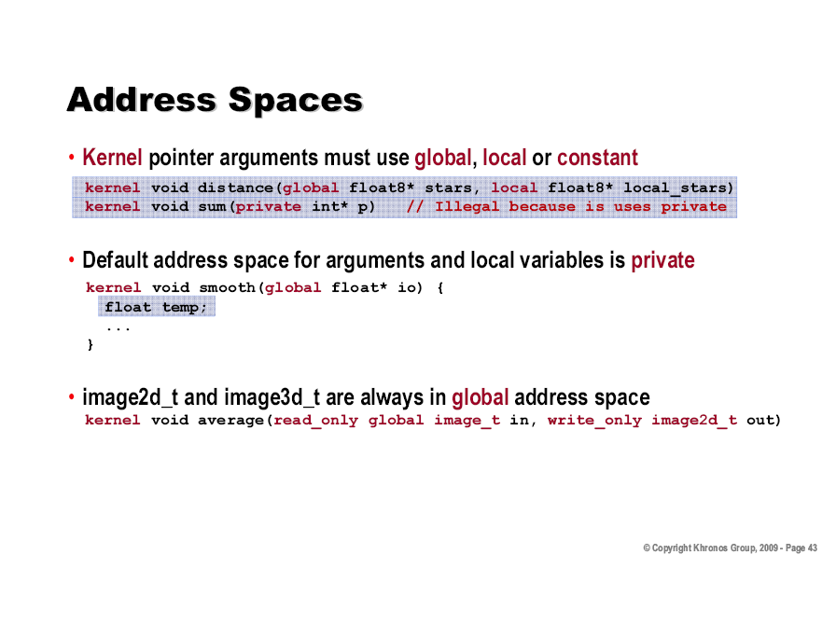

Slide 55
CUDA vs OpenCL API Differences
Naming Schemes
How data gets passes to the API
C for CUDA programs are compiled with an external tool (NVCC compiler)
OpenCL compiler it typically invoked at runtime (you can offline compile too)

Slide 56
CUDA
OpenCL
cuInit(0);
cuDeviceGet(&hContext, 0);
cuCtxCreate(&hContext, 0, hDevice));
CUdeviceptr pDeviceMemA, pDeviceMemB, pDeviceMemC;
cuMemAlloc(&pDeviceMemA, cnDimension * sizeof(float));
cuMemAlloc(&pDeviceMemB, cnDimension * sizeof(float));
cuMemAlloc(&pDeviceMemC, cnDimension * sizeof(float));
// copy host vectors to device
cuMemcpyHtoD(pDeviceMemA, pA, cnDimension * sizeof(float));
cuMemcpyHtoD(pDeviceMemB, pB, cnDimension * sizeof(float));
cuFuncSetBlockShape(cuFunction, cnBlockSize, 1, 1);
cuLaunchGrid (cuFunction, cnBlocks, 1);
cl_context hContext;
hContext = clCreateContextFromType(0, CL_DEVICE_DEVICE_TYPE_GPU, 0,0,0);
cl_mem hDeviceMemA, hDeviceMemB, hDeviceMemC;
hDeviceMemA = clCreateBuffer(hContext,
CL_MEM_READ_ONLY | CL_MEM_COPY_HOST_PTR,
cnDimension * sizeof(cl_float), pA, 0);
hDeviceMemB = clCreateBuffer(hContext,
CL_MEM_READ_ONLY | CL_MEM_COPY_HOST_PTR,
cnDimension * sizeof(cl_float), pA, 0);
hDeviceMemC = clCreateBuffer(hContext,
CL_MEM_WRITE_ONLY,
cnDimension * sizeof(cl_float) 0, 0);
clEnqueueNDRangeKernel(hCmdQueue, hKernel, 1, 0,
&cnDimension, &cnBlockSize, 0, 0, 0);

Slide 57
CUDA Pointer Traversal
struct Node { Node* next; }
n = n->next; // undefined operation in OpenCL,
// since ‘n’ here is a kernel input

Slide 58
OpenCL Pointer Traversal
struct Node { unsigned int next; }
…
n = bufBase + n; // pointer arithmetic is fine, bufBase is
// a kernel input param to the buffer’s beginning

Slide 59
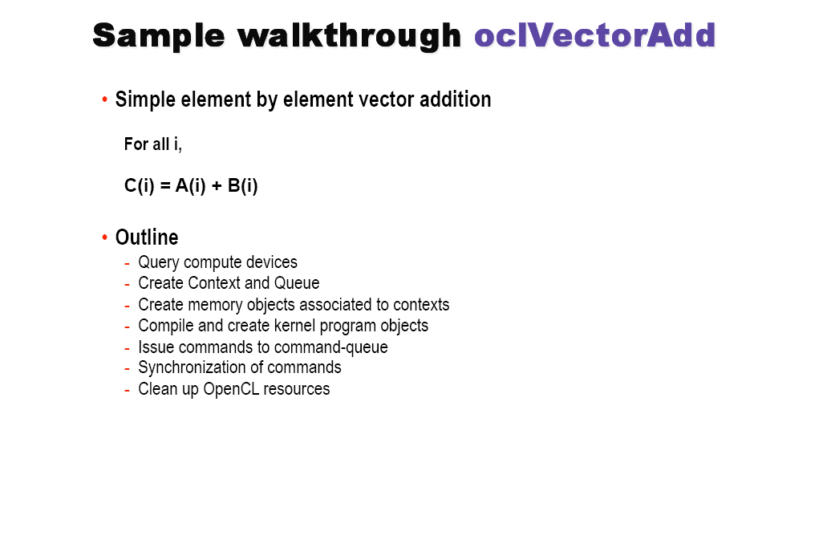

Slide 60
CUDA Kernel code:
__global__ void
vectorAdd(const float * a, const float * b, float * c)
{
// Vector element index
int nIndex = blockIdx.x * blockDim.x + threadIdx.x;
c[nIndex] = a[nIndex] + b[nIndex];
}

Slide 61
OpenCL Kernel code:
__kernel void
vectorAdd(__global const float * a,
__global const float * b,
__global float * c)
{
// Vector element index
int nIndex = get_global_id(0);
c[nIndex] = a[nIndex] + b[nIndex];
}
CUDA kernel functions are declared using the “__global__” function modifier
OpenCL kernel functions are declared using “__kernel”.

Slide 62
CUDA Driver API Host code:
const unsigned int cnBlockSize = 512;
const unsigned int cnBlocks = 3;
const unsigned int cnDimension = cnBlocks * cnBlockSize;
CUdevice hDevice;
CUcontext hContext;
CUmodule hModule;
CUfunction hFunction;
// create CUDA device & context
cuInit(0);
cuDeviceGet(&hContext, 0); // pick first device
cuCtxCreate(&hContext, 0, hDevice));
cuModuleLoad(&hModule, “vectorAdd.cubin”);
cuModuleGetFunction(&hFunction, hModule, "vectorAdd");
// allocate host vectors
float * pA = new float[cnDimension];
float * pB = new float[cnDimension];
float * pC = new float[cnDimension];
// initialize host memory
randomInit(pA, cnDimension);
randomInit(pB, cnDimension);
// allocate memory on the device
CUdeviceptr pDeviceMemA, pDeviceMemB, pDeviceMemC;
cuMemAlloc(&pDeviceMemA, cnDimension * sizeof(float));
cuMemAlloc(&pDeviceMemB, cnDimension * sizeof(float));
cuMemAlloc(&pDeviceMemC, cnDimension * sizeof(float));
// copy host vectors to device
cuMemcpyHtoD(pDeviceMemA, pA, cnDimension * sizeof(float));
cuMemcpyHtoD(pDeviceMemB, pB, cnDimension * sizeof(float));
// setup parameter values
cuFuncSetBlockShape(cuFunction, cnBlockSize, 1, 1);
cuParamSeti(cuFunction, 0, pDeviceMemA);
cuParamSeti(cuFunction, 4, pDeviceMemB);
cuParamSeti(cuFunction, 8, pDeviceMemC);
cuParamSetSize(cuFunction, 12);
// execute kernel
cuLaunchGrid(cuFunction, cnBlocks, 1);
// copy the result from device back to host
cuMemcpyDtoH((void *) pC, pDeviceMemC, cnDimension * sizeof(float));
delete[] pA; delete[] pB; delete[] pC;
cuMemFree(pDeviceMemA); cuMemFree(pDeviceMemB); cuMemFree(pDeviceMemC);

Slide 63
OpenCL Host Code:
const unsigned int cnBlockSize = 512;
const unsigned int cnBlocks = 3;
const unsigned int cnDimension = cnBlocks * cnBlockSize;
// create OpenCL device & context
cl_context hContext;
hContext = clCreateContextFromType(0, CL_DEVICE_TYPE_GPU,
0, 0, 0);
// query all devices available to the context
size_t nContextDescriptorSize;
clGetContextInfo(hContext, CL_CONTEXT_DEVICES,
0, 0, &nContextDescriptorSize);
cl_device_id * aDevices = malloc(nContextDescriptorSize);
clGetContextInfo(hContext, CL_CONTEXT_DEVICES,
nContextDescriptorSize, aDevices, 0);
// create a command queue for first device the context reported
cl_command_queue hCmdQueue;
hCmdQueue = clCreateCommandQueue(hContext, aDevices[0], 0, 0);
// create & compile program
cl_program hProgram;
hProgram = clCreateProgramWithSource(hContext, 1,
sProgramSource, 0, 0);
clBuildProgram(hProgram, 0, 0, 0, 0, 0);
// create kernel
cl_kernel hKernel;
hKernel = clCreateKernel(hProgram, “vectorAdd”, 0);
// allocate host vectors
float * pA = new float[cnDimension];
float * pB = new float[cnDimension];
float * pC = new float[cnDimension];
// initialize host memory
randomInit(pA, cnDimension);
randomInit(pB, cnDimension);
// allocate device memory
cl_mem hDeviceMemA, hDeviceMemB, hDeviceMemC;
hDeviceMemA = clCreateBuffer(hContext,
CL_MEM_READ_ONLY | CL_MEM_COPY_HOST_PTR, cnDimension * sizeof(cl_float), pA, 0);
hDeviceMemB = clCreateBuffer(hContext, CL_MEM_READ_ONLY | CL_MEM_COPY_HOST_PTR, cnDimension * sizeof(cl_float), pA, 0);
hDeviceMemC = clCreateBuffer(hContext, CL_MEM_WRITE_ONLY, cnDimension * sizeof(cl_float), 0, 0);
// setup parameter values
clSetKernelArg(hKernel, 0, sizeof(cl_mem), (void *)&hDeviceMemA);
clSetKernelArg(hKernel, 1, sizeof(cl_mem), (void *)&hDeviceMemB);
clSetKernelArg(hKernel, 2, sizeof(cl_mem), (void *)&hDeviceMemC);
// execute kernel
clEnqueueNDRangeKernel(hCmdQueue, hKernel, 1, 0, &cnDimension, 0, 0, 0, 0);
// copy results from device back to host
clEnqueueReadBuffer(hContext, hDeviceMemC, CL_TRUE, 0, cnDimension * sizeof(cl_float), pC, 0, 0, 0);
delete[] pA; delete[] pB; delete[] pC;
clReleaseMemObj(hDeviceMemA); clReleaseMemObj(hDeviceMemB); clReleaseMemObj(hDeviceMemC);

Slide 64
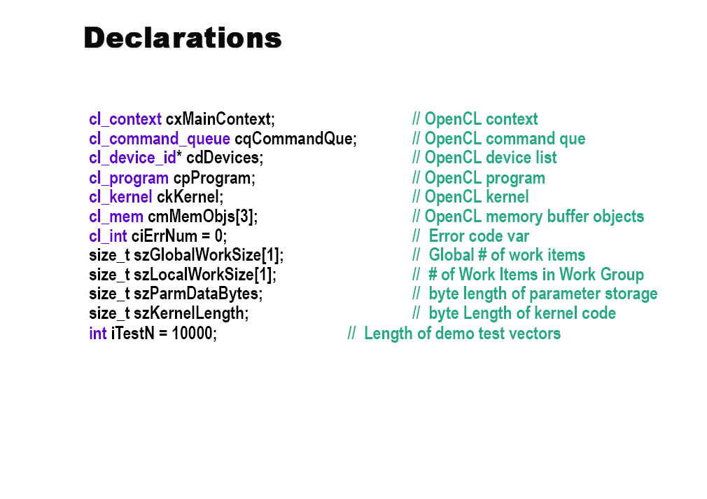

Slide 65
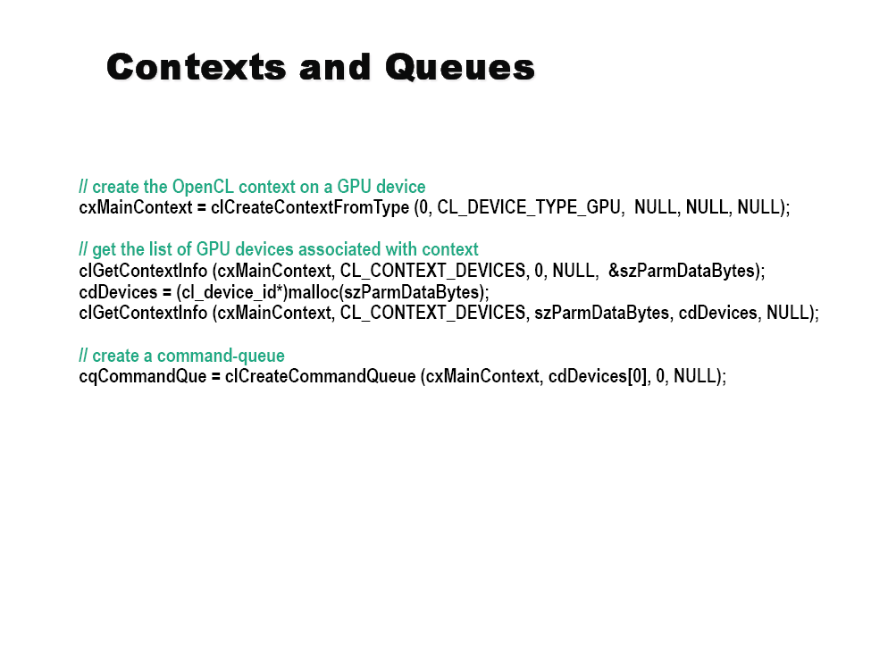

Slide 66


Slide 67


Slide 68


Slide 69


Slide 70


Slide 71


Slide 72


Slide 73

Personal Aside …
I’m a bit skeptical…
1) slower
2) NVIDIA has to fully commit…
Source: Matt Harvey Porting CUDA to OpenCL

Slide 74

More Performance notes…
Source: Matt Harvey Porting CUDA to OpenCL

